Slide 1
Multiple Disease Detection Using Machine Learning
Nikhil Patel (Team Leader)
Lucky Mohabe (Team Member)
Pankaj Kachhi(Team Member)
Neeraj Pal (Team Member)

Slide 2
INTRODUCTION
we are proposing a system which can be used to predict multiple diseases
The multiple disease detection system uses data from multiple patient records to predict if a person has good chance of having a disease.
In this system, we are going to analyze Diabetes, Heart, Kidney, Liver and Malaria disease analysis.
Data in the healthcare industry consists of all the information related to patients
Here a general architecture has been proposed for predicting the disease in the healthcare industry
Many of the existing models are concentrating on one disease per analysis (Like one analysis for diabetes, one for cancer, one for skin diseases like that.)
There is no common system present that can analyze more than one disease at a time.

Slide 3
IMPLEMENTATION
To implement multiple disease analyses we are going to use machine learning algorithms and Streamlet.
Our basic idea is to develop a system which will predict and give the details of the disease predicted along with its severity which as symptoms are given as input by the user.
The system will compare the symptoms with the datasets provided in the database.

Slide 4
Test Available
Breast Cancer Test
Diabetes Test
Heart Disease Test
Kidney Disease Test
Liver Disease Test
Parkinsons Disease Test

Slide 5
Names of datasets used to predict diseases
Breast Cancer : Winconsin Breast Cancer Dataset
Diabetes : Pima Indian Diabetes Dataset
Liver : Indian Patient Liver Records
Heart : Heart Disease Dataset
Kidney : Chronic Kidney Disease Dataset
Parkinson's Disease : Parkinsons Disease Data Set

Slide 6
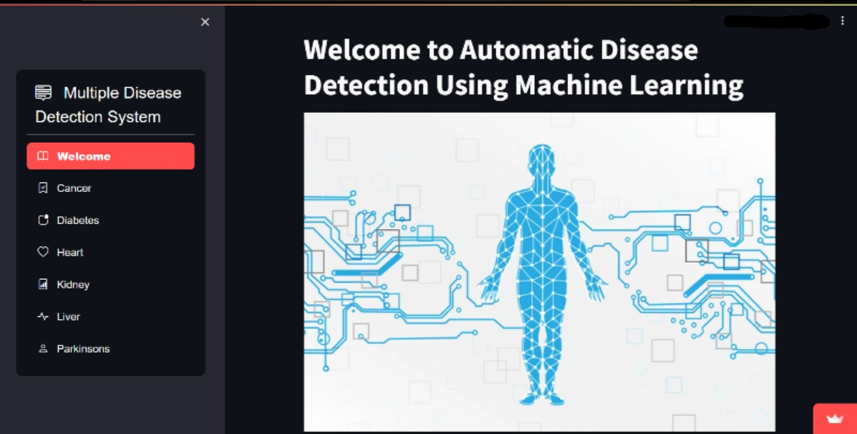
Homepage of the WebApp

Slide 7
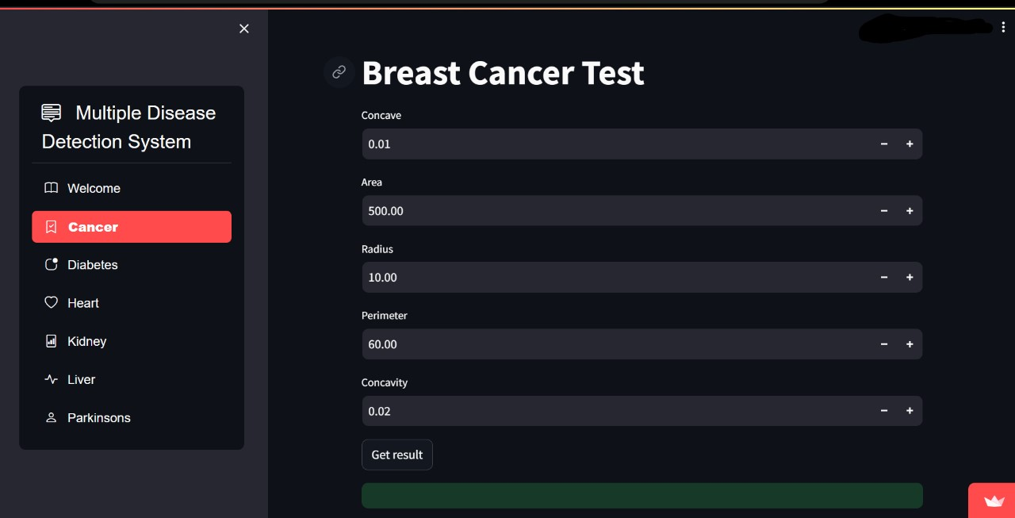
Breast Cancer Test

Slide 8
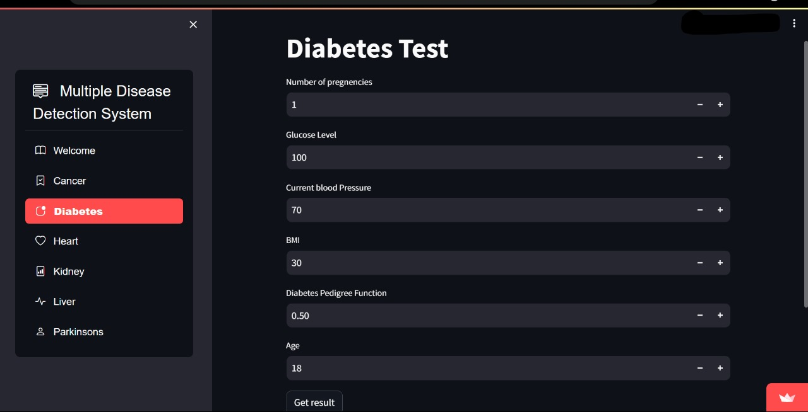
Diabetes Test

Slide 9
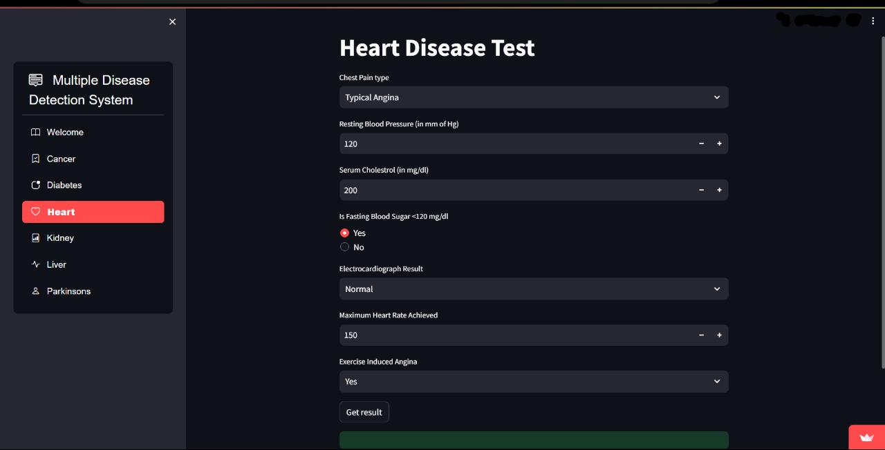
Heart Disease Test

Slide 10
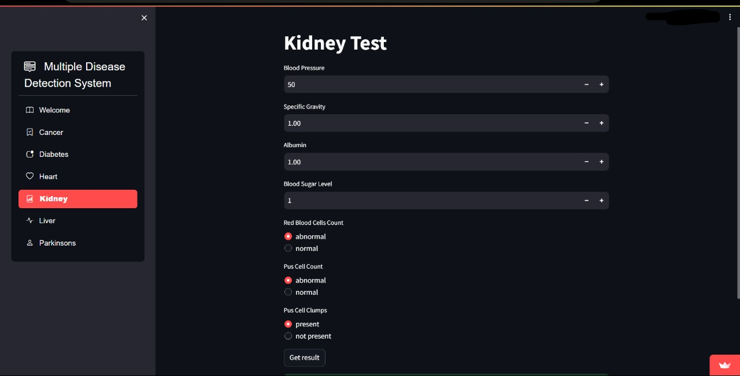
Kidney Test

Slide 11
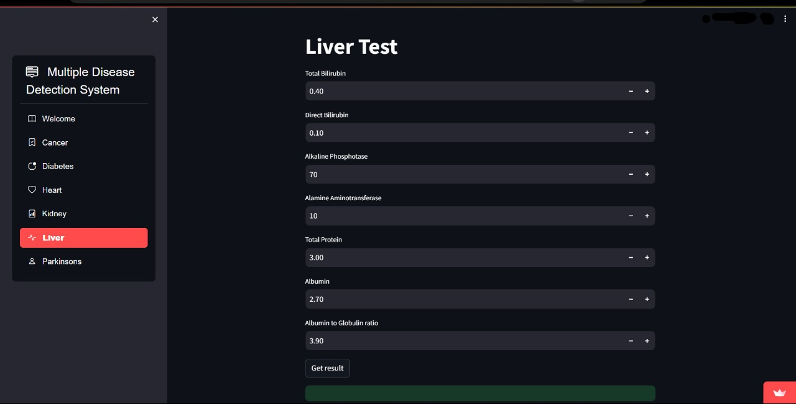
Liver Test

Slide 12
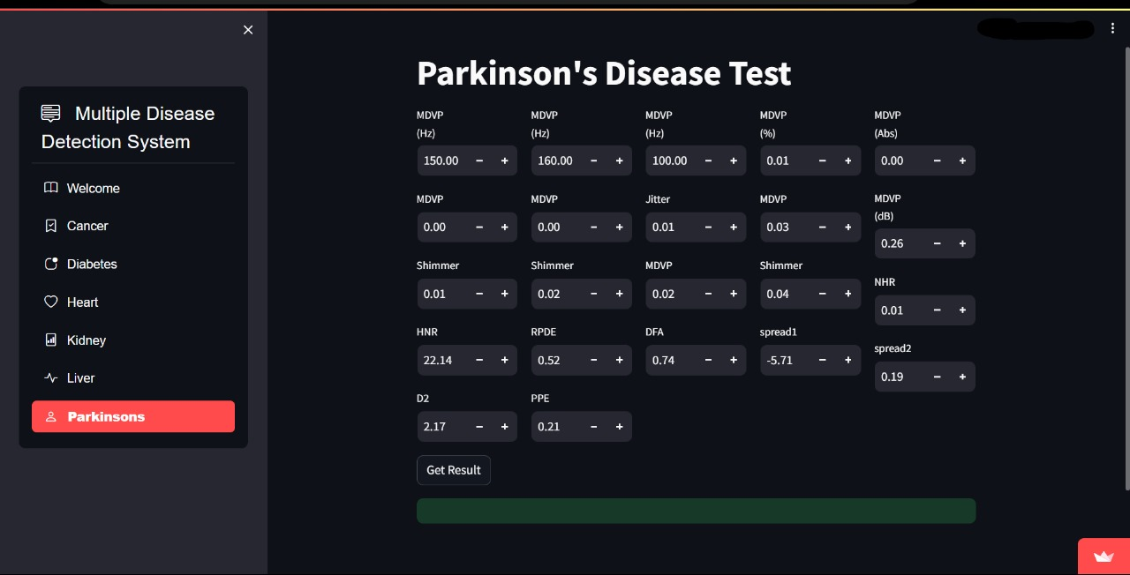
Parkinsons Disease Test

Slide 13








TECHNOLOGY STACKS

Slide 14
THANK YOU

